Slide 1
Curriculum Night
Mrs. April Cornett
Room B-7

Slide 2
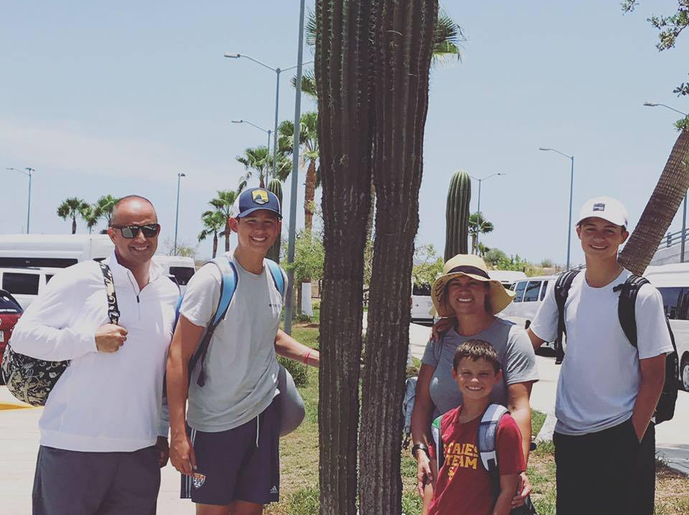
All About Me
12th year teaching
B.A. from Morehead State University
Degree in Elementary Education and Special Education with an emphasis in Learning and Behavior Disorders
Love camping, football, golf, baseball, running, and spending time with my family

Slide 3
Contact Information Email: cornetta@Issaquah.wednet.edu Phone Number: 425.837.4122 Website: cornettclass@weebly.com
* Please allow 48 hours for an email or phone response*

Slide 4
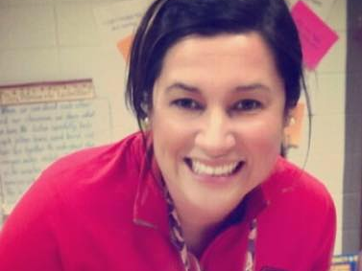
I BELIEVE IN…
Cultivating an environment of kindness
Teaching independence and responsibility
Helping students with social and emotional needs are just as important as academic achievement
Individualized instruction to meet all student needs
Celebrating strengths
Mistakes are proof that you are trying

Slide 5
Mrs. Cornett’s Corner The Class Website is designed to: Check the Weekly SnapShot Find More Information about assignments review calendar for assessments additional resources to meet student and parent needs
https://cornettclass.weebly.com

Slide 6
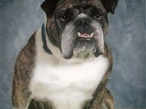
CLASSROOM EXPECTATIONS
“BARKS”
Be…
Accountable
Respectful
Kind
Safe

Slide 7
ABSENCE Creating A Responsible Student Check:
Website
Missing Assignment Folder Ask a Peer Speak with a Teacher or Paraprofessional

Slide 8
Classroom Policies
Water bottles
Snacks
Sign-in/sign –out policy to go to the restroom
Students should go to lockers and restroom in between classes or with teacher permission

Slide 9
Inside Language, Literacy, and Content
Developed by National Geographic – Hampton Brown
It supports both reading and writing
Has multiple volumes to differentiate instruction
Emphasizes vocabulary, genre, building background comprehension, literary analysis, and grammar
Scope Magazine and grade level material will be integrated into the program

Slide 10
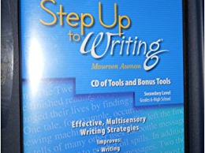
Step Up to Writing
Effective, multisensory Writing Strategies
Builds skills to Improve:
Writing
Reading
Speaking
Listening
Students will also use grade level curriculum for long term writing projects

Slide 11
Writing Projects
6th Grade Writing Projects
Personal Narrative
Feature Article
Argumentative Essay
7th Grade Writing Projects
Memoir
Book Review
Photo Essay
Washington State Project using Sway
8th Grade Writing Projects
Memoir
Argumentative Essay
Research Paper

Slide 12
Learning Strategies
This class is designed to help support Social/Emotional and Executive Functioning

Slide 13
SNAPSHOT OF LEARNING STRATEGIES
MINDFULNESS MONDAY (self-regulation)
TALK ABOUT IT TUESDAY (problem solving/growth mindset/executive functioning)
WORK ON IT WEDNESDAY (check grades/individualized conference/make-up missing assignments)
THINK ABOUT IT THURSDAY (executive functioning)
FUN FRIDAY (working in groups/conversational skills/self-regulation)
*Each day the class will focus on a social/emotional component or an executive functioning skill in a fun, interactive class*
*This class is participation based and students will journal and chart to show progress*

Slide 14
Thank you Please feel free to contact me at any time to assist you
Thank you for all of your support with PTSA, school fundraisers, and the Issaquah School Foundation

